Slide 1
Image Matching
Intensity-based matching:
less robust to noise/blurring;
less stable for complex deformations (e.g. projective);
good for multimodal image registration.
Fourier domain methods:
can be used only up to similarity model;
fast.
Feature-based methods:
robust;
fast;
can be used for complex deformations;
sometimes features can not be found.

Slide 2
Feature-based matching
Consists of the following steps:
Feature extraction for both images
Feature descriptor (some statistics of feature point proximity) computation
Feature matching
Deformation estimation (usually via RANSAC)
There are a lot of feature points/descriptors:
Blob detectors:
SIFT (excellent but slow)
SURF (close to SIFT but extremely faster)
BRISK (less accurate but much faster then SURF)
…
Corner detectors (more simple but less robust):
FAST
Harris
Eigenvalues
…

Slide 3
Feature/descriptor extraction

Slide 4
Feature matching

Slide 5
Deformation estimation
Initial difference
Difference after matching

Slide 6
Deformation estimation
Initial difference
Difference after matching

Slide 7
Results

Slide 8
Results

Slide 9
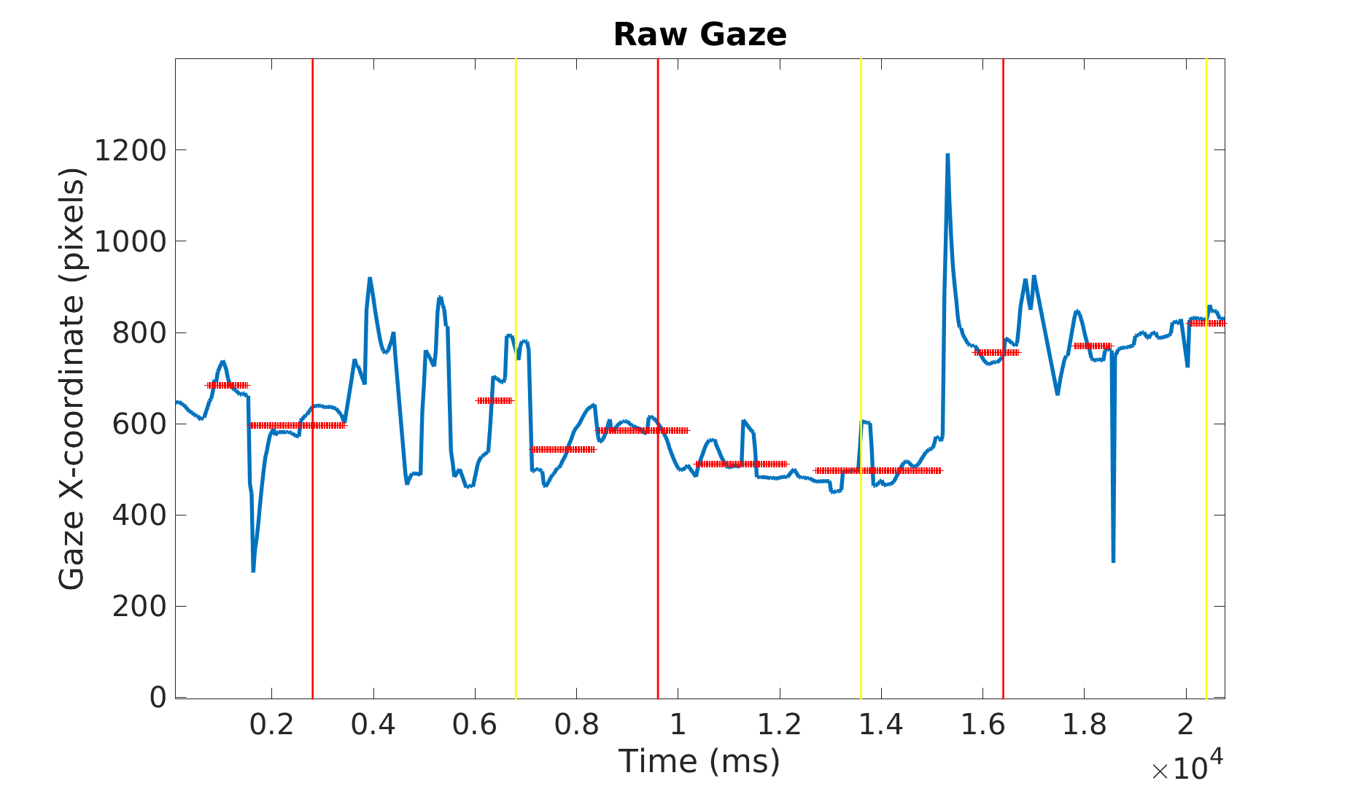
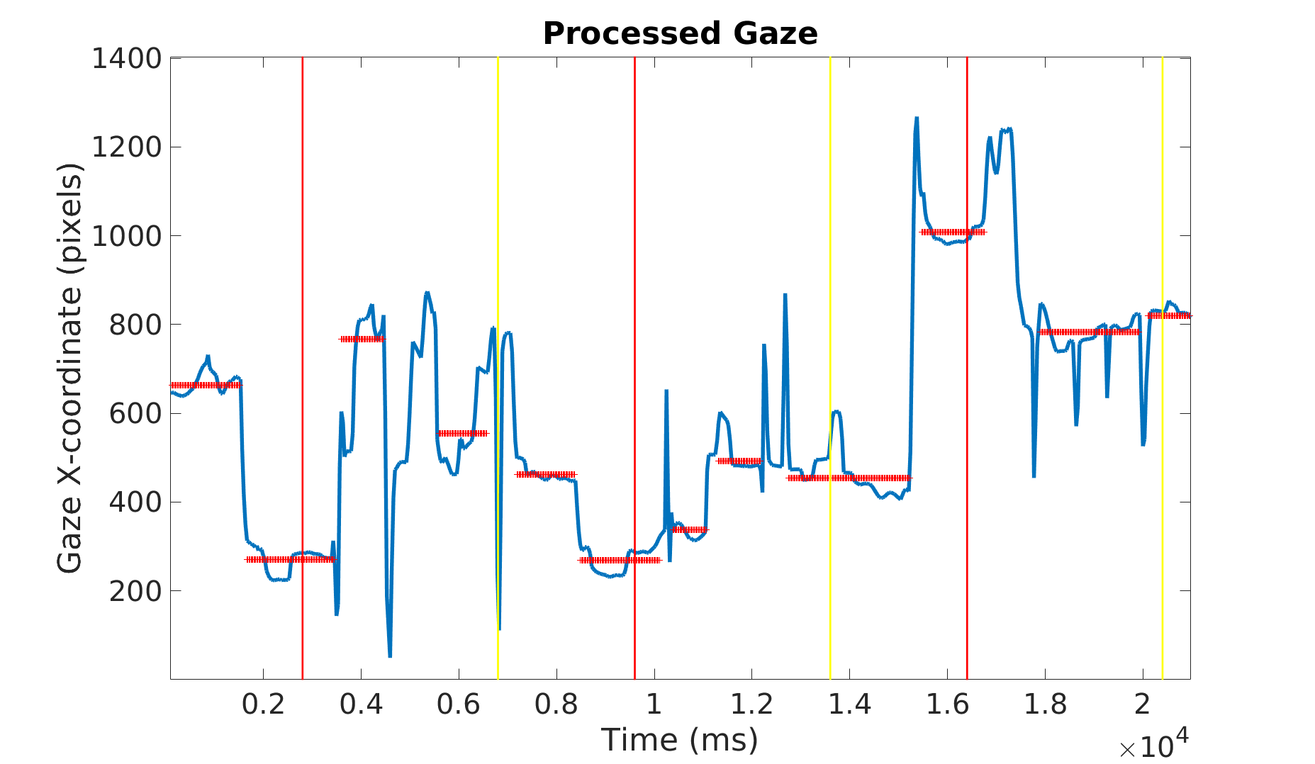
Results

Slide 10
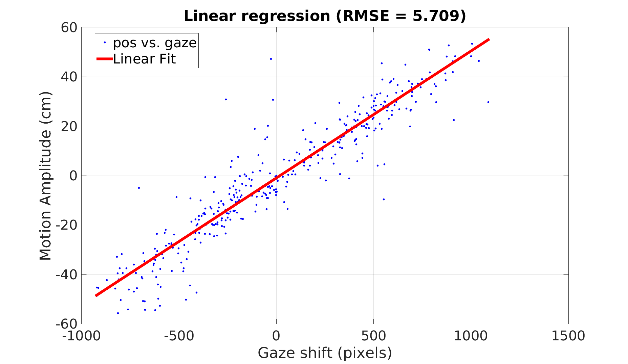
Results

